Slide 1
CRIC-365
DASARI HNNSK SRINIVASA RAO
ID : 2081597
CLASS: HCI 440
DATE : 09/15/2022

Slide 2
DESCRIPTION
Cric-Buzz features articles, news and live coverage of Cricket matches.
It provides the fastest ball-by-ball commentary and score with live action, with cricket news, photo galleries etc..,
It contains information about each player, teams, upcoming and Recent matches etc.,
They provides user-friendly interface and update the news, scores and stats of players and teams within no time.

Slide 3
DESCRIPTION
The Integrated experience available called Cric-Buzz. But my application will add features like online gambling of every cricket match playing across the world with fair odds, along with more player and team stats to help the user about current form.
How users will benefit of using this new integrated experience - User can have all the odds of the cricket match and do cricket gambling.
Best part of our integrated experience is - it only deals with cricket gambling with no other sport in it and we will be providing button to on and off for viewing odds as user wanted
In Cric-Buzz, we don’t have any feature of viewing odds of cricket match

Slide 4
AFFORDANCES
Cognitive Affordance – Enable user to learning, understanding the game and policies
Providing an app logo icon with button in it to help user to know about the things are.
Odds buttons for all the matches will be viewed under the odds bar.
Scroll down to view more matches.
By providing a balance on screen for letting the user know about the balance.
Physical Affordance – Enable user to do something physically.
By providing the scroll bar to scroll it up/down physically to view more matches.
Providing the account balance in top right corner with link to view all the transactions.
Providing a buttons with odds on it with color changes when odds are changing to place a bet and after clicking on it, user will see the popup of default keypad with numbers to enter the amount to place bet.

Slide 5
AFFORDANCES
Sensory Affordance – Enable user in sensing
User can sense, scrolling down by seeing the scroll down bar for more matches.
User can sense that odds are changing by color changes on odds button.
when user clicks on odds button, the button color will get darker on loading to sense and popup of keypad with default numbers to enter the amount.
User will see the loading symbol, when something is submitted.
Functional Affordance – Helping user to accomplish the work.
When a live-match is going on, user can place a bet to win/loss.
When a user won the bet, user can withdraw it to bank account from cric-365 account.
When a user loss the bet, user can deposit more amount into cric-365 account.

Slide 6
USERS
User 1 : Users want to play the gambling.
User can enable gamble button. User can place bets for match with the help of updated score. After the game dies, automatically the application will be settling all the amount for win/loss, it will update the amount in user account.
User can also view all the bets placed. If something is not fair, then user can report the action. So that respective admin team will act on that.
User will disable the gamble button, if user wants to view the scores and commentary without odds.

Slide 7
USERS
User 2 : Users want to know the team-score.
User can disable the gamble button. So that the user can only view the match score without any odds.
User can watch all the scores, news and update about the teams & players.
With ball-by-ball scores, user can get the real time enjoyment.

Slide 8
USER1- SCENARIOS 1
Before application
Here is the user named Kane. During his summer vacation he wants to invest some money into gambling. He is very much interested in cricket. So, he decided to invest some money in cricket gambling.
He wants to application to do that. So, he decided to deposit some money into other gambling. but he faced some problems during the match like assessing the situation and due to the all-sports gambling availability. He confused a lot with lot of matches. He was not able to place a bet at right time and with no availability of commentary, he cannot assess the situation, he lost all the money.

Slide 9
USER1 -SCENARIOS 2
While using application
So, one of his friend suggested the Cric-365, where he can assess the situation and all the bets in application belongs to cricket. So that he can place the bets easily.
Kane downloaded Cric-365. he started using the application and his account got verified within no time. He deposited some money. He placed bet with assessing the situation well with ball-by-ball commentary and view all the odds.
He verified all the bet history and as a cricket fan, he felt this application is user friendly and easy to use and he happily withdrawn the almost.

Slide 10
USER1 -SCENARIOS 3:
After using application:
One day met his friend, he will ask Kane about returns and application. Kane is very happy with application and returns. It mentioned about user friendly interface, how easily it is easy to assess the situation and how easy to deposit/withdraw the money. He showed all his bet history to his friend.
After using this application. He suggested this application to few of his friends and they were happy with the application.

Slide 11
SKETCHES (BEFORE)

Slide 12
SKETCHES (WHILE USING)

Slide 13
SKETCHES (AFTER)

Slide 14
USER2 – SCENARIOS 1
Before application
Here is the user named Willy. During his summer vacation in his hometown. He is very much interested in cricket. Cricket World-cup is going on. But due to the power issue in his village. He is not able to follow the match.
He wants to application to do that. So, he decided to download some application. During match time, he opened that application and viewing the scores of that match then match is completed. But he is not so happy with the application as it is not showing commentary of balls played and It just shows the score of the match.

Slide 15
USER2 -SCENARIOS 2
While using application
So, one of his friend suggested the Cric-365, where he can can just disable the gambling button. So that he can view only commentary of every match.
Willy installed Cric-365 and disabled the gamble button and followed the entire match with all the commentary of every ball played. He enjoyed the match with all the stats, updated scores. He can see all the post match presentations. Willy is very happy with the Cric-365 application.

Slide 16
USER 2 -SCENARIOS 3
After using application:
One day met his friend, He asked willy about the cric-365 application. Willy responded very happily, and he loved this application as a cricket fan.
and After using this application. He suggested this application to new other friends, and he showed all the tricks and accessibility about the application which will be useful to them to enjoy the game.

Slide 17
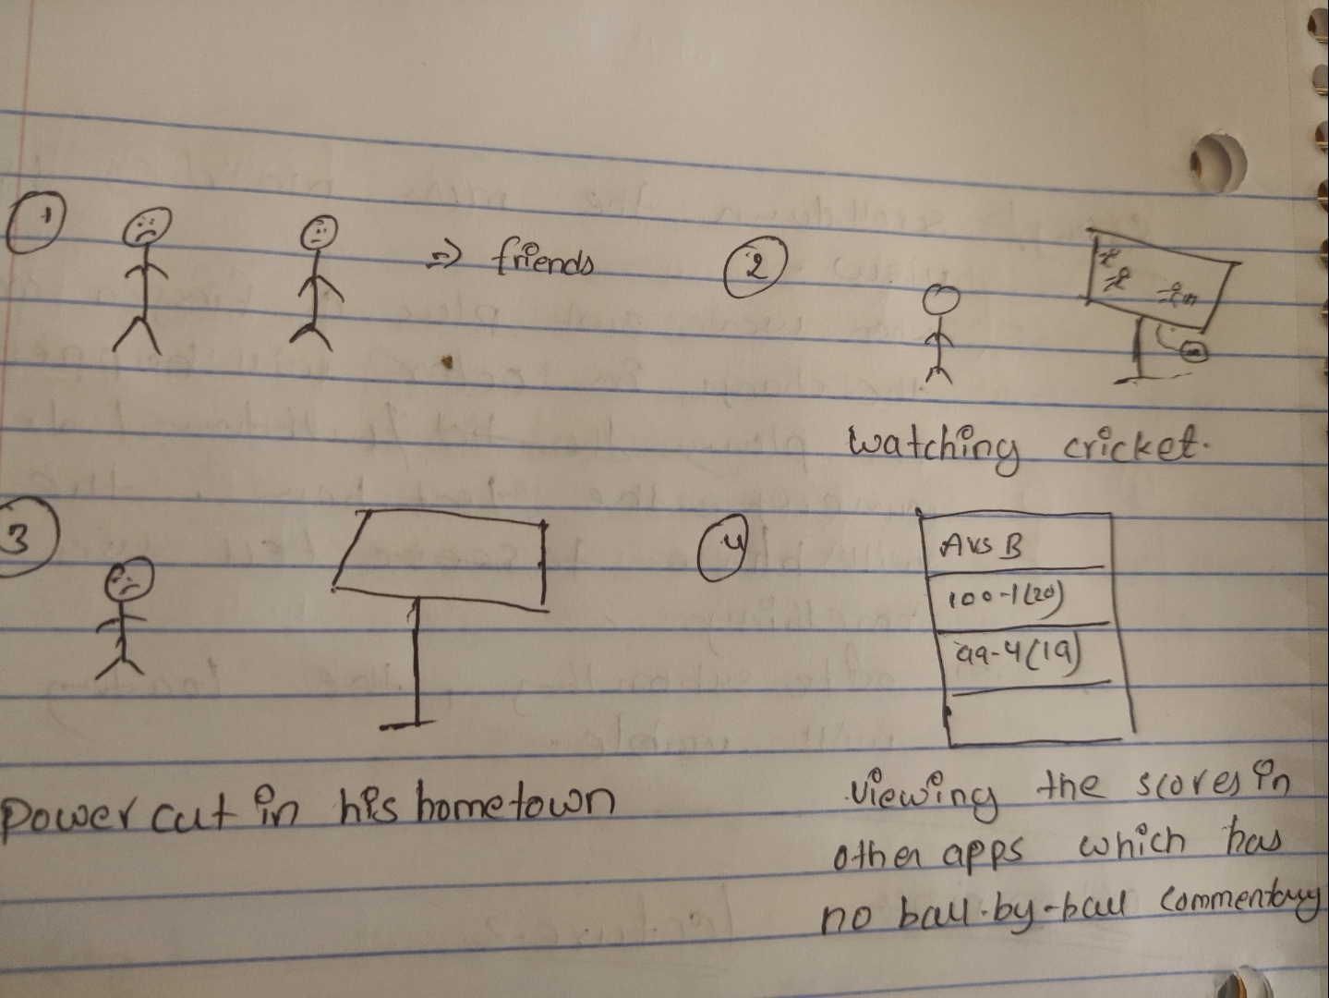
SKETCHES (BEFORE)

Slide 18
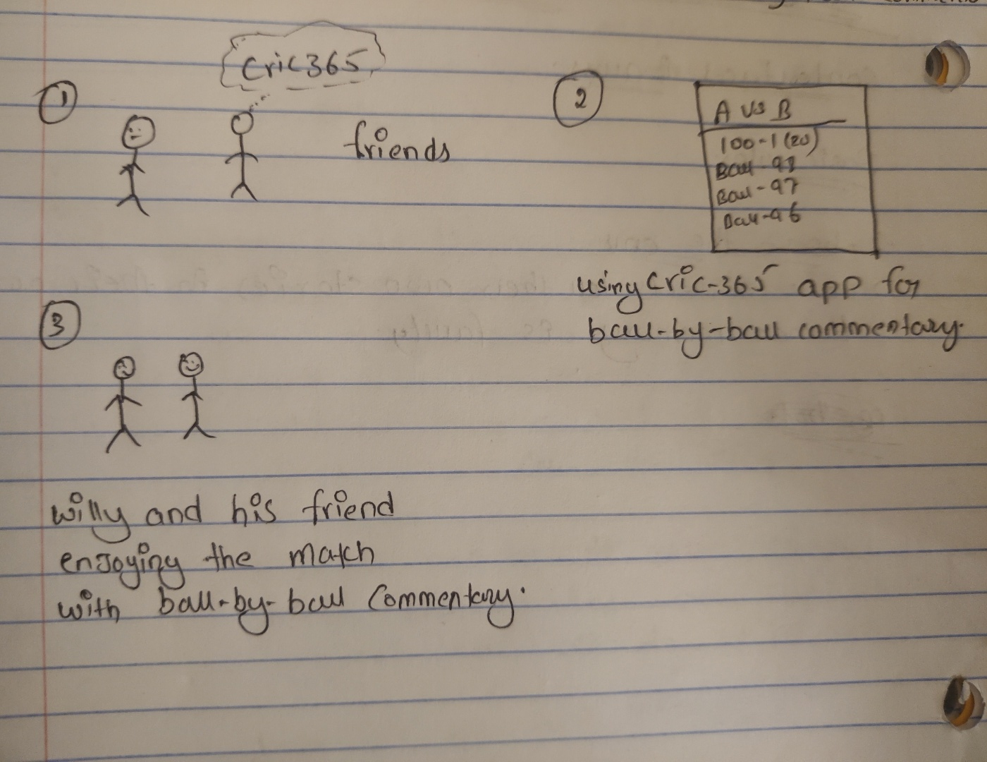
SKETCHES (WHILE USING)

Slide 19
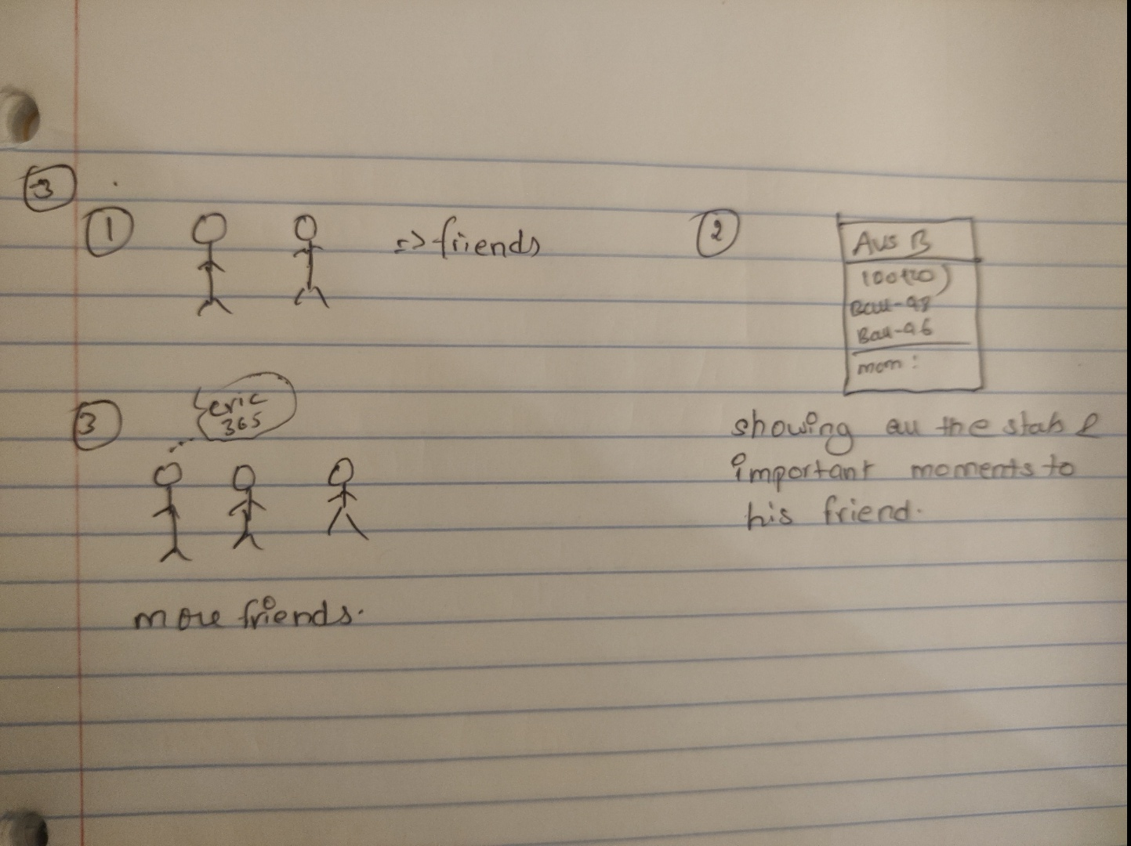
SKETCHES (AFTER)

Slide 20

POTENTIOAL PROBLEMS
While placing the bets, sometimes bets may not get placed
To over come, make sure the system has better internet connection.
Deposit/withdrawal delay due to bank server issues
Make sure no issue with respect to bank
Ball-by-Ball commentary will get delayed by 10 seconds
Nothing can be done for this.
User should be logged in on multiple devices.
During the gambling time, Make sure use logged in at 1 device and also, we will be providing log-out on other devices option to view the logins.
Live chat with the Agent.
Due to high traffic, Agent responses may get delayed. So, user needs to patient for a while to get the response back.

Slide 21
INSIGHTS
Ideas : Great ideas will make the application build further; it plays an important role.
Affordance : Something that helps a user do make things clear and to perform tasks.
Users : It shows how many possible ways that we can bulil an application.
Scenarios/Sketches : Best way to understand the application with sketches/scenarios
Potential Problems : Problems which user can face while using the application.

Slide 22
ADDITIONAL INTERACTIVE EXPERIENCE IDEAS
Ventra :
This application is used in some parts of USA. Currently it is not a great user-friendly interface . Looking forwards to apply more design with latest technology.
Virtual reality for concerts and events
Creating a virtual reality for concerts , events etc., to make user life easy.
Travel alarm
This application helps user to set destination while traveling. By using the GPS, the alarm will trigger when you are nearing to destination.
Park-here
This application helps user to park their vehicles in busy areas like Chicago, helps user to find best parking slot near his/her location.
E-Book
This application helps user to write a notes with e-pen, when user clicks on next page , application will store the previous data in one page and allows user to write more on next page and so on

Slide 23
THANK YOU

